Slide 1
Linguistic Gaming with Python:
File Input/Output & Internet Data
Qi Yu, 16.12.2022

Slide 2
Organizational Issues
No lecture next week (Dec. 23, 2022)!
Information of the final project will be given available before the next session on Jan. 13, 2023.
Please download the code for today’s session from ILIAS if you haven’t done it yet: We will use some files there during the session.

Slide 3
Content for Today
File input/output
Handling data from internet (specifically: HTML-files)
For self-learning: Hammond (2020), Chapter 8.8 – How to build a simple web crawler

Slide 4
File Input/Output

Slide 5
File I/O
File I/O (reading in files / writing files):
The basic logic:
create a stream to a file → read from / write to the stream → close the stream
Stream: A stream represents an input source or an output destination
Read in files: Two different ways
1) Read in a whole file
2) Read in a file line by line
DEMO: file_io/input.py
Write files:
DEMO: file_io/output.py

Slide 6
File I/O
We have used the function open() for file I/O.
Summary: Arguments of open()
open(file, mode='r')
mode: OPTIONAL argument
‘w’ = writing
‘r’ = reading (default value)
…
(see Python documentation [HERE]
for many more options)
file: REQUIRED argument.
It specifies path of the file.

Slide 7
File I/O
File overwriting: This happens when giving the file the same name as an existing file in the same directory (DANGEROUS!)
DEMO: file_io/overwrite.py
→ NEVER use important files for learning or experimenting! You can accidentally overwrite important data.
Instead: create copies and play with them
The safest way: create a new directory as your “playground”

Slide 8
Conducting Large-Scale Text Analysis using File I/O
File I/O allows us to conduct analyses on large documents. In what follows, we will see a real-life case:
We will work with the file file_io/alice.txt from ILIAS.
Hands-On 1:
Write a program to…
read in the file alice.txt.
count how many lines the file has, and then print out the result. The result should be 5685.
store all lines in a list named all_lines. Then print out the first 100 lines in all_lines.

Slide 9
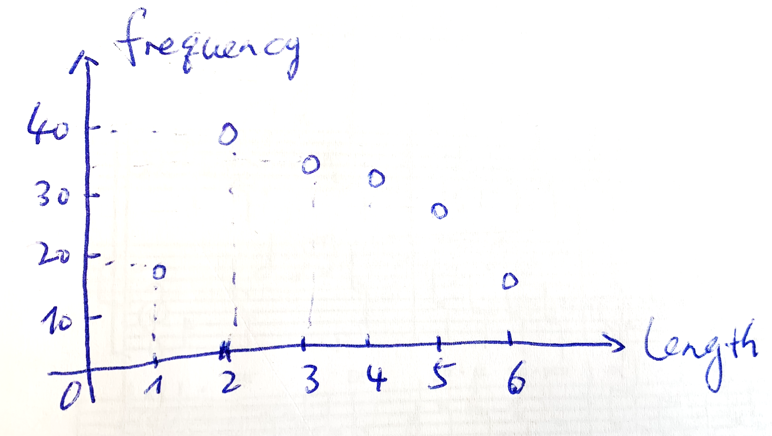
Conducting Large-Scale Text Analysis using File I/O
Now we have read in alice.txt. As a next step, we will inspect alice.txt further and tackle a pseudo-research-question:
In alice.txt, is there a correlation between word length and word frequency?
(It’s generally believed that more frequent words are shorter than less frequent words.)
For doing this, we need two things:
The length of each word
The frequency of each length
We won’t calculate the correlation today, but we will see how to get the data ready for this aim.
To this end, we can build a length-frequency dictionary which looks roughly like the follows:
length_freq_dict = {1: 19, 2: 40, 3: 37, 4: 36, 5: 30, …}

Slide 10
Conducting Large-Scale Text Analysis using File I/O
Goal: We need a length-frequency dictionary which looks like the follows:
length_freq_dict = {1: 19, 2: 40, 3: 37, 4: 36, 5: 30, …}
But, when you take a closer look at alice.txt:
The part until line 166 and the part starting from line 5408 are preamble and project information, but not main text
We’d rather do some text cleaning before proceeding…
DEMO: file_io/alice.py (Part 2)

Slide 11
Conducting Large-Scale Text Analysis using File I/O
Goal: We need a length-frequency dictionary which looks like the follows:
length_freq_dict = {1: 19, 2: 40, 3: 37, 4: 36, 5: 30, …}
We need to break each line into words, in order to get the length and frequency of each word.
How? We can use .split(), a method for string splitting
DEMO: file_io/string_split.py

Slide 12
Conducting Large-Scale Text Analysis using File I/O
Goal: We need a length-frequency dictionary which looks like the follows:
length_freq_dict = {1: 19, 2: 40, 3: 37, 4: 36, 5: 30, …}
Hands-On 2:
You will build your script from Hands-On 1 further.
For each line of the main text (line 166-5408), split the line by white space. By doing this, we approximate the procedure of splitting the lines to words.
Then append all words from all lines to a list named words, and use len()to check how many words the file has.
Print out all words in words

Slide 13
Conducting Large-Scale Text Analysis using File I/O
Goal: We need a length-frequency dictionary which looks roughly like the follows:
length_freq_dict = {1: 19, 2: 40, 3: 37, 4: 36, 5: 30, …}
If you have a closer look at the “words” we got from .split(), you will see that there is one problem: They contain punctuations.
Principally, we need to strip them.
But for the purpose of illustrating how to use Python to do large-scale text analysis, we will just pretend that the words are clean, and build length_freq_dict based on them.
How can we build the length_freq_dict? (Time for you to think…)
DEMO: file_io/alice.py (Part 4)

Slide 14
Handle Data from Internet

Slide 15
Internet Data
Two things need to be dealt with, when obtaining data from internet:
HTML
Text encoding

Slide 16
Internet Data: HTML
HTML (Hypertext Markup Language):
The standard markup language for creating web pages
Markup language: A markup language is metadata for annotating a document (i.e. webpage)
→ It “tells” the browser how to display the content
DEMO: internet_data/simple_html.html

Slide 17
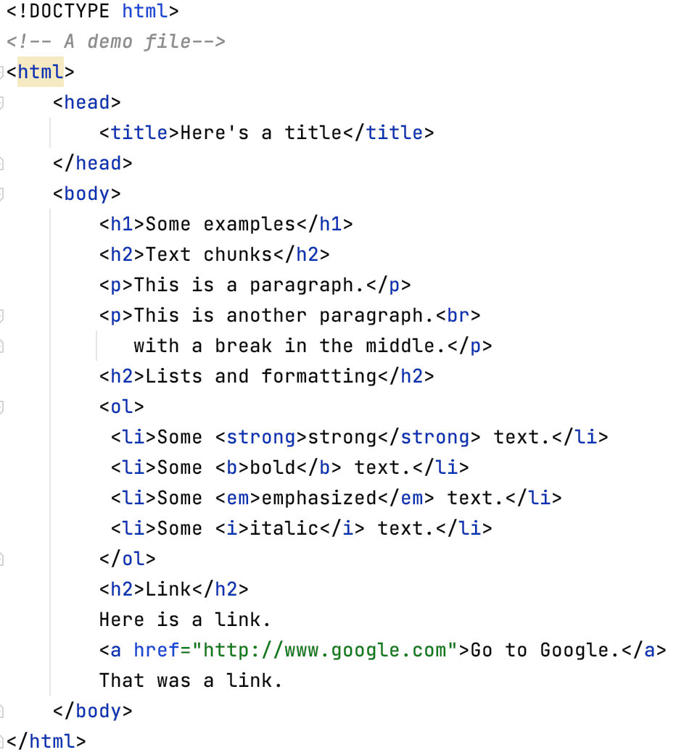
Internet Data: HTML
<!DOCTYPE html> : declaring that this document is an HTML5 document
<!-- … --> : marks a comment
<html> : the root element of an HTML page
<head> : contains meta information about the page
<title> : specifies a title for the HTML page (which is shown in the browser's title bar or in the page's tab)
<body> : defines the document's body, and is a container for all the visible contents, such as headings, paragraphs, images, hyperlinks, tables, lists, etc.
<h1>, <h2> : define headings
<p> : defines a paragraph
<ol> : defines an ordered list
<li> : defines a list item
<a> : defines a hyperlink
<strong>, <b>, <em>, <i>: define fonts
paired tags
unpaired tag
tag attribute

Slide 18
Internet Data: HTML
Retrieving a website and parsing the HTML:
We will use:
the urllib.request module for retrieving the website
the BeautifulSoup() method in the module bs4 for parsing HTML
DEMO: internet_data/web.py

Slide 19
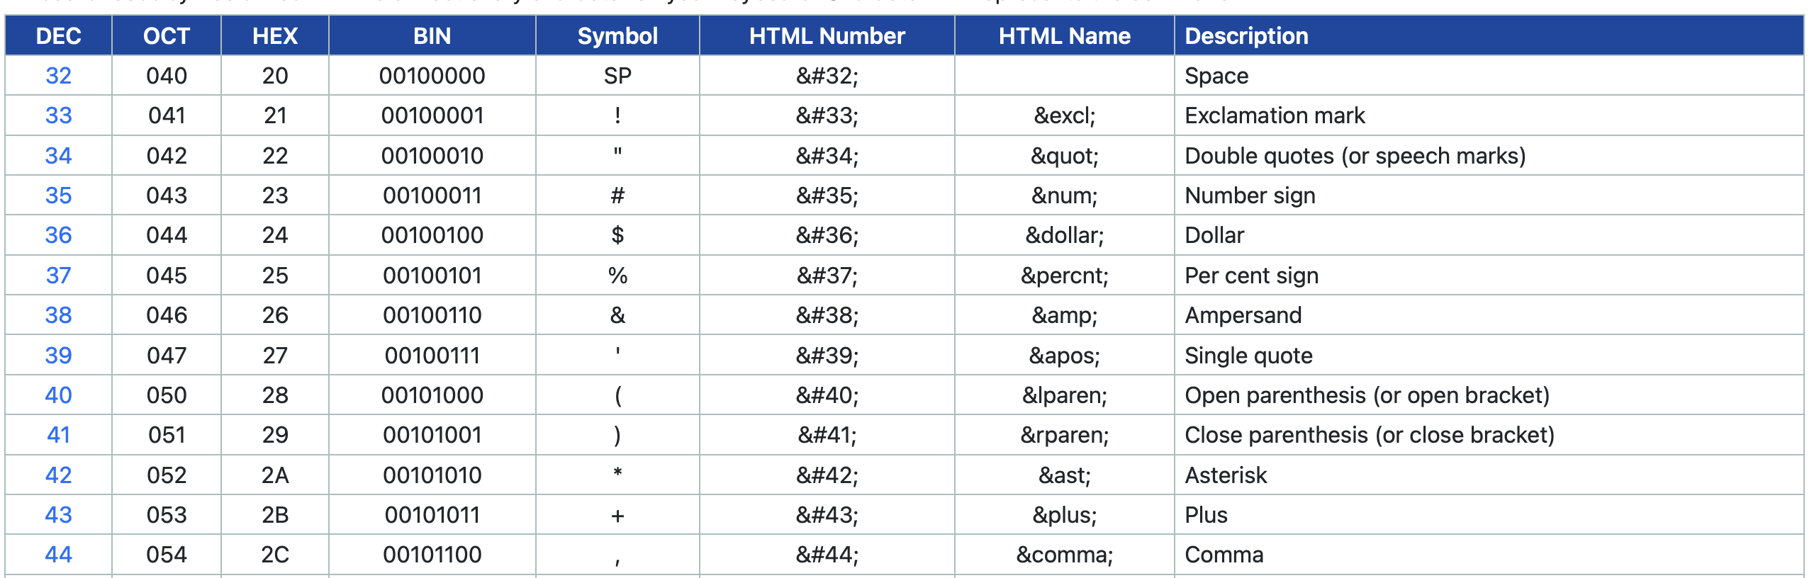
Internet Data: Text Encoding
How texts are represented in computers: in binary form → “0”s and “1”s…
Different text encoding standards:
ASCII: 7-bit character code → capable for encoding 2⁷ = 128 characters
See: https://www.ascii-code.com

Slide 20
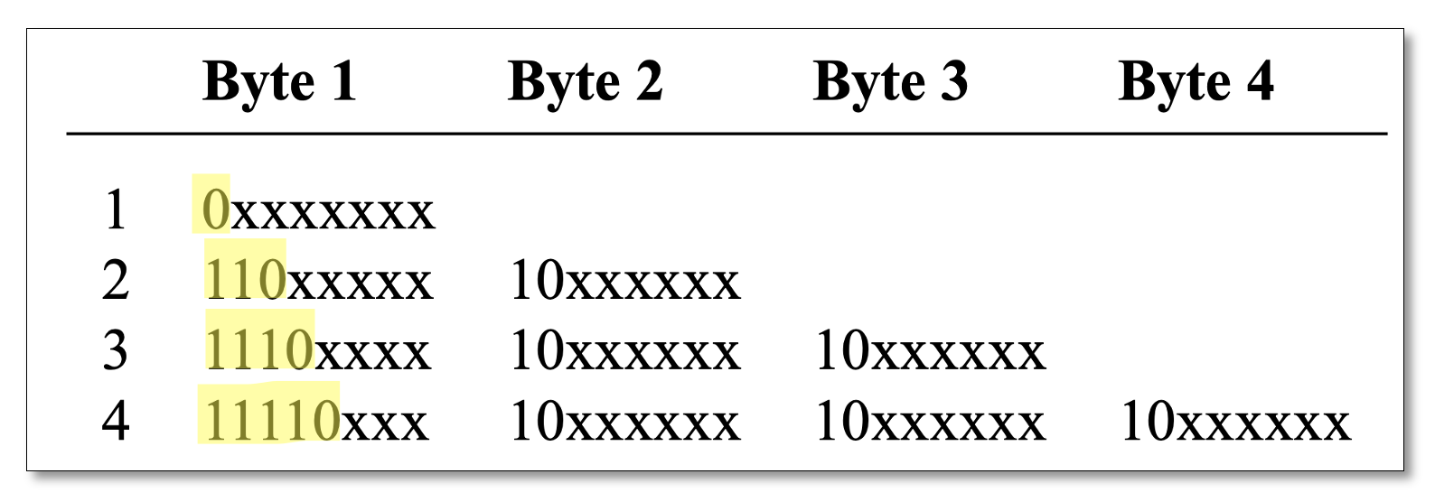
Internet Data: Text Encoding
Different text encoding standards:
UTF-8: 1 to 4 bytes are used for encoding each characters (1 byte = 8 bits)
The highlighted parts mark the start of a multibyte-group
E.g., “110” indicates the following byte also belong to the same group, and these two bytes together represent one character;
“1110” indicates the following 2 bytes also belong to the same group, and these three bytes together represent one character;
UTF-8 is capable for encoding 1,112,064 characters
(Source: Hammond 2020)

Slide 21
Internet Data: Text Encoding
Dealing with encodings:
Python is natively UTF-8
DEMO: encoding.py (Part 1-2)
Dealing with encodings other than UTF-8:
Using open(), but set the argument mode as 'rb' (read bytes) or 'wb' (write bytes) to read/write the file in bytes
Then encode/decode the bytes
DEMO: internet_data/encoding.py (Part 3)

Slide 22
Internet Data: Text Encoding
Detect the encoding of a text:
Two Python modules can be used:
chardet
UnicodeDammit from package bs4
DEMO: internet_data/encoding_detection.py

Slide 23
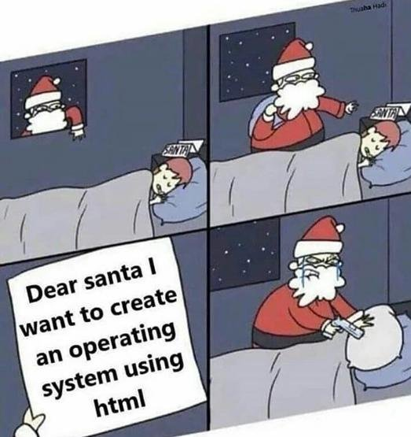
No lecture next week
- A merry Christmas
and a happy new year!

